Slide 1

Predicting 2017/18 NHL Salaries
Shawn Michael
MSDS 692 Capstone 1
Regis University

Slide 2
Agenda
Overview
Dataset
Data Cleaning
Exploration of the Data
Model Creation and Evaluation
Project Summary

Slide 3

Overview
The National Hockey League salaries during the 2017/2018 season ranged from the league min of $650,000 to $13.8 million. The intent of the project is to model several Machine Learning techniques to predict player salaries. In addition, to the modeling, it is also important to clean, understand and discover meaning from the dataset.

Slide 4
Dataset
NHL 2017-18.zip was put together by Robert Vollamn
The dataset for this project was extracted from
http://www.hockeyabstract.com/testimonials/nhl2017-18
NHL 2017-18.xlxs contains 199 variables and 881 objects
Many of the variables listed in the flat file are sub objects of summary variables
The cleaned spreadsheet trims this total to ~30 columns

Slide 5
Data Cleaning
Reading the data into R, I used the library(readr), which is a component of the tidyverse package
readr library is a powerful tool for parsing while ingesting data into r
It reduces over time formatting but using three main components:
Rectangular Parsers
Column specification
Vector parsers
Learn more at https://readr.tidyverse.org/articles/readr.html
Automatically handles missing data
Drops
Fills with most recent non-NA data
Replace_NA

Slide 6
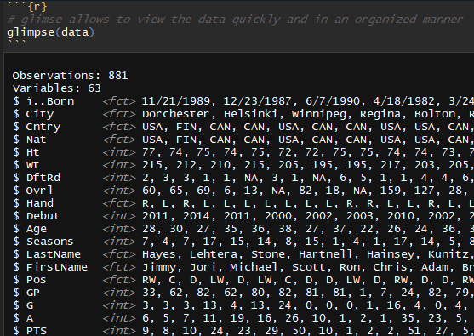
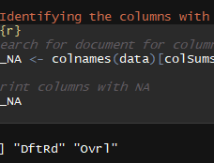
Data Cleaning Continued
Glimpse from tidyverse is a great tool to view the data easily
The dataset had two variables that contained NA’s, which I was somewhat shock by. There is a good reason why these columns would contain NA’s, since there are many players in the NHL that who were never drafted.
Was able to clean up some addition variables and make them useable for the model.

Slide 7
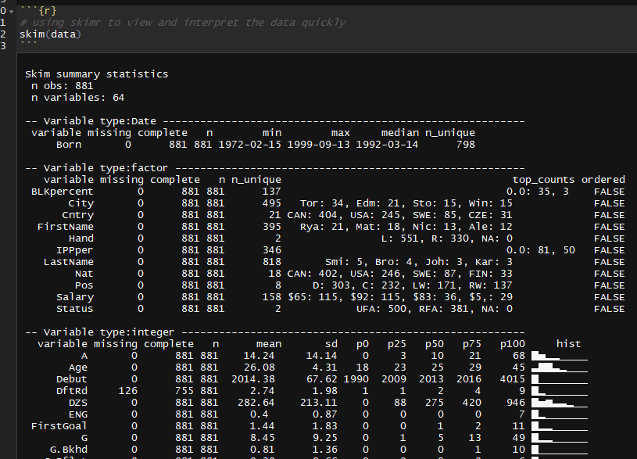
Data Exploration
First step is to get a sense of what type of data is available in the dataset and the best tool I have found for this is skim.
Able to view the important data in one place.
Objects and variables
Data is grouped by variable type
Variable name, missing or not, count of objects
Statics seen with summary(), plus a histogram

Slide 8

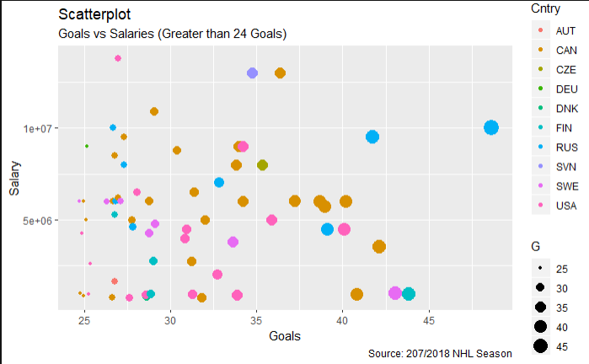
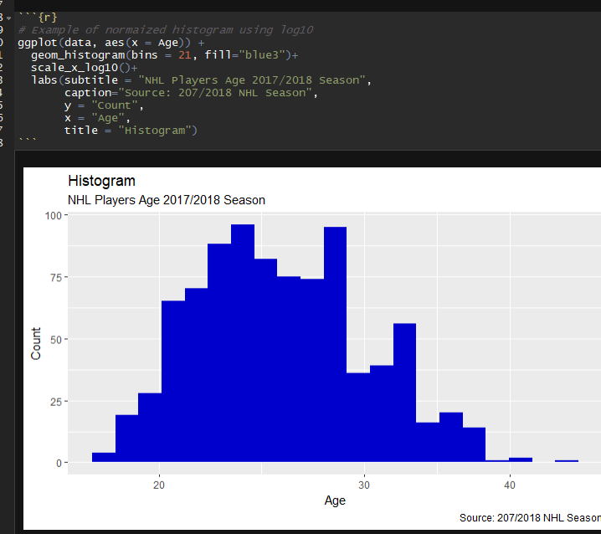
2017/2018 NHL Data Visualization

Slide 9
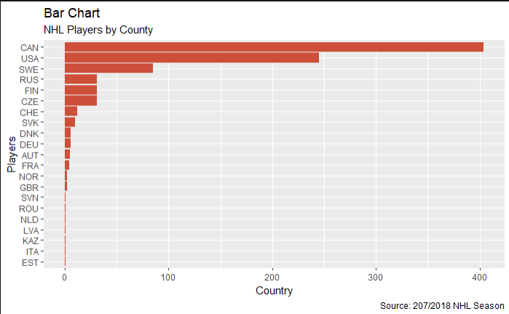
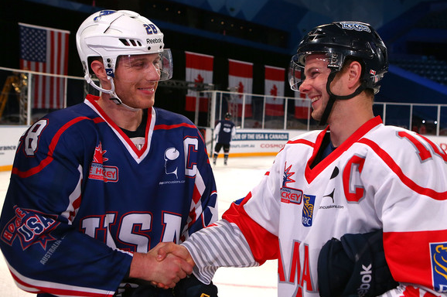
International Players

Slide 10
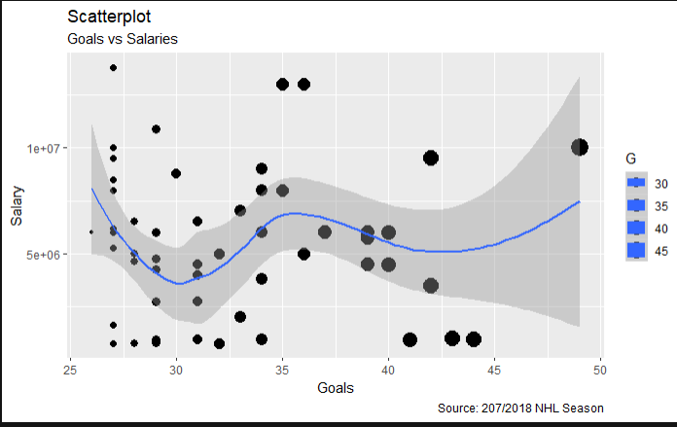
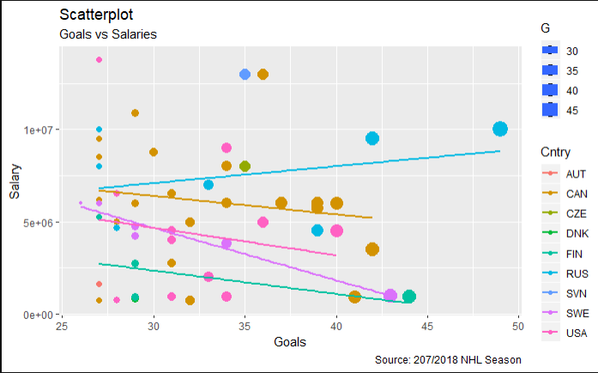
Scatterplots

Slide 11
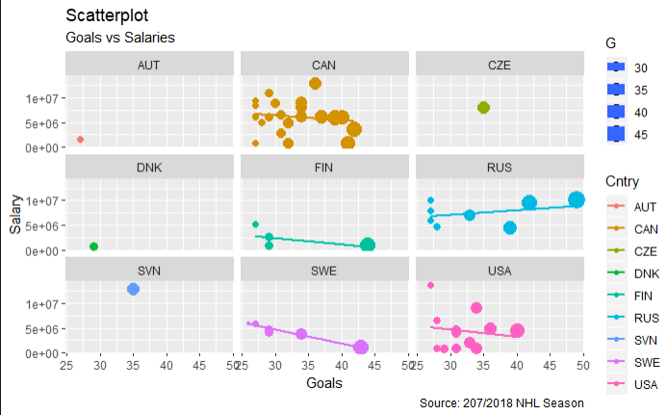
Scatterplot with Facet_Wrap

Slide 12
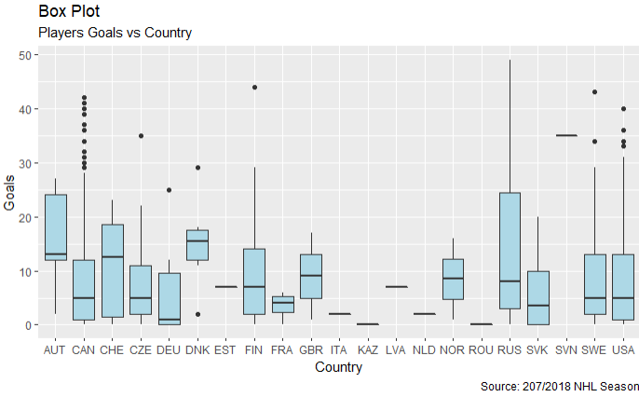
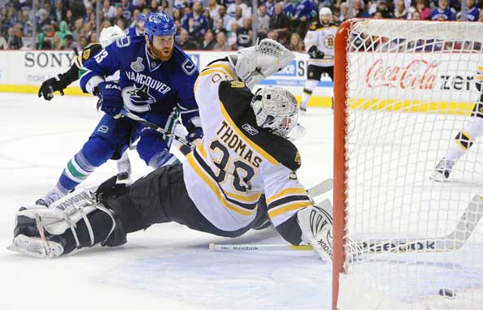
Players Goals per Country

Slide 13
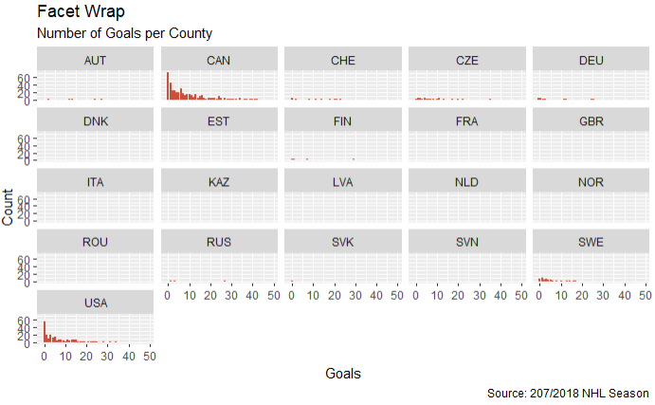

Slide 14
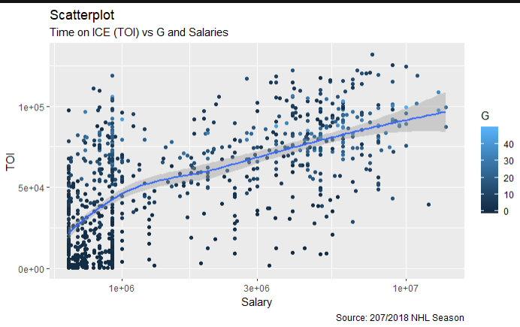
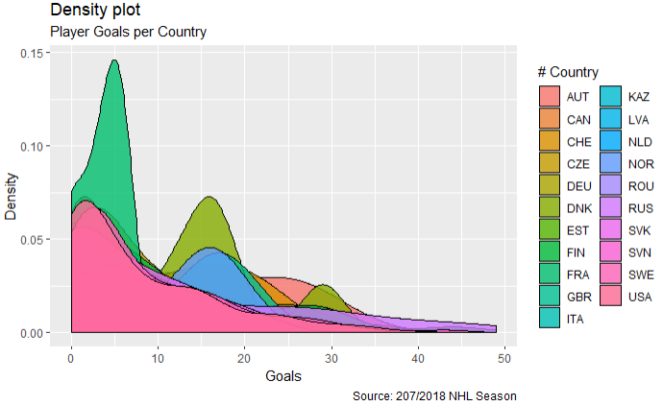

Slide 15
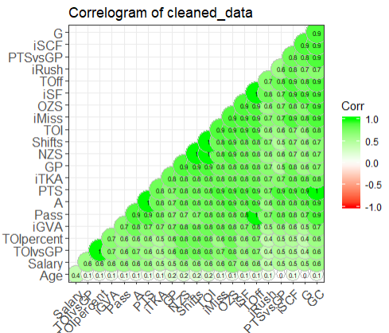
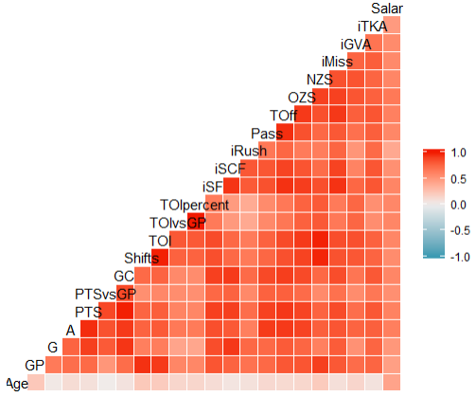
Data Correlation

Slide 16
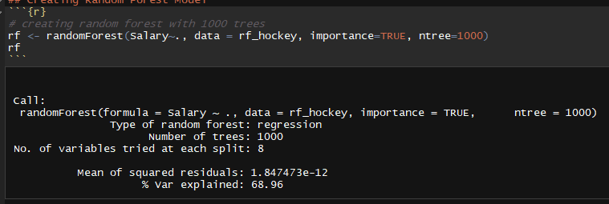
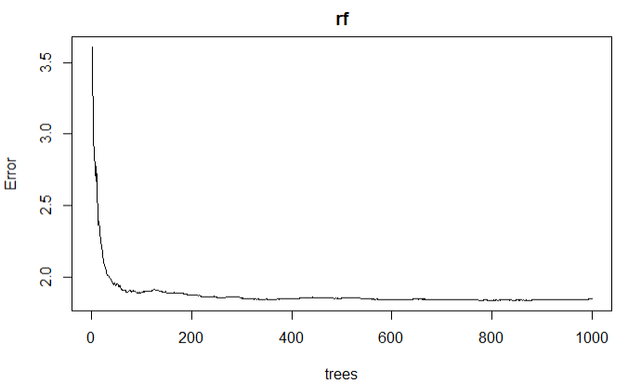
Random Forest

Slide 17
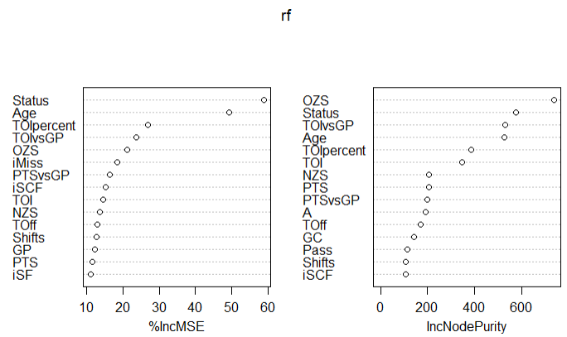
Importance Variables - RF

Slide 18
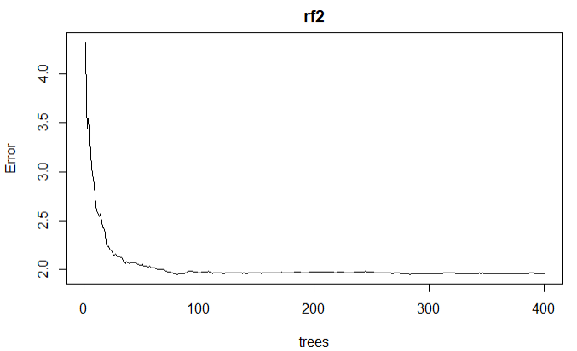
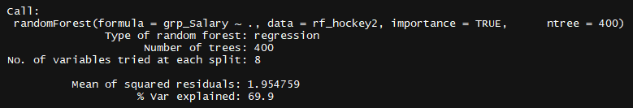
Second Run for Random Forest

Slide 19
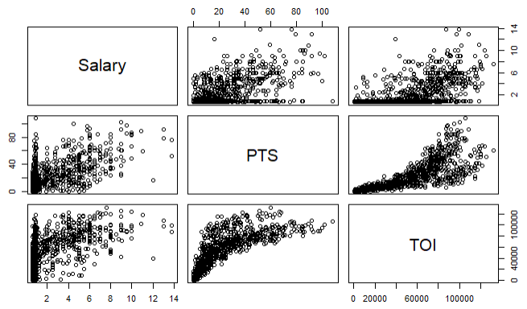
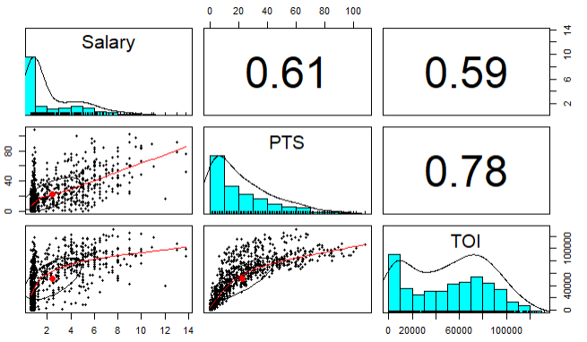
Decision Tree (DT)

Slide 20
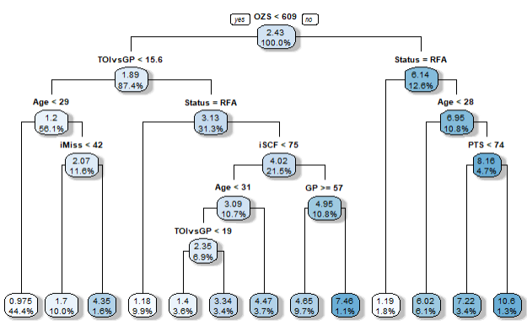
Regression Tree
Root Node Error: 6.036
N=619
MAE = 1.063867
RMSE = 1.631958

Slide 21
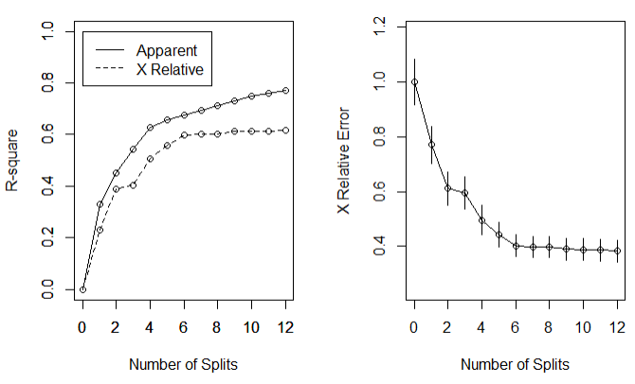
Number of Splits

Slide 22
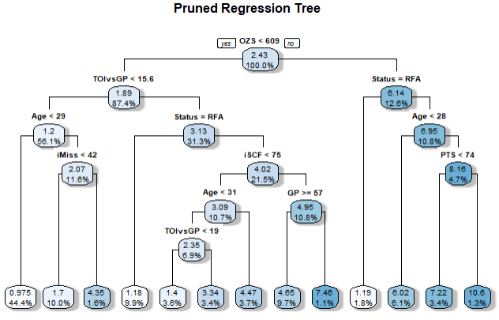
Pruned Regression Tree

Slide 23
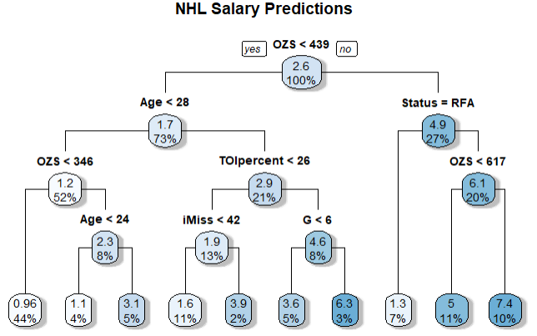
2nd DT – Grouped Salaries
Root Node Error: 6.036
N=618
MAE = 0.9933494
RMSE = 1.523315

Slide 24
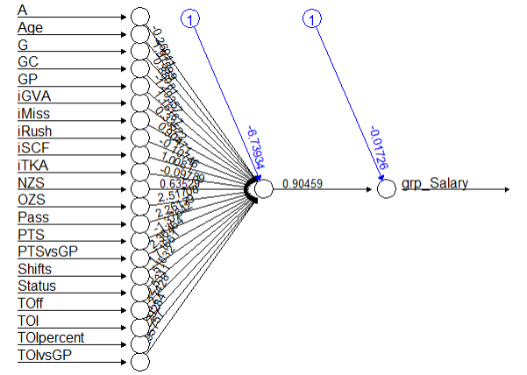
Neural Network
Hidden = 1
MAE = 0.0669543
RMSE = 0.1056555

Slide 25
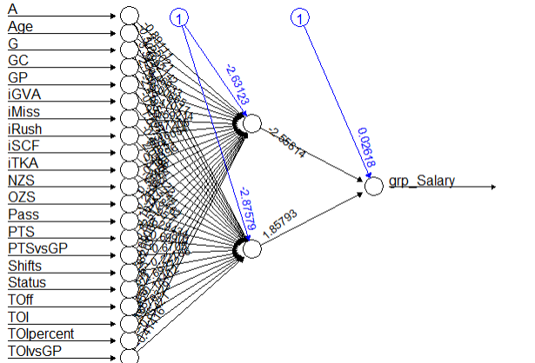
Neural Network – run 2
Hidden = 2
MAE = 0.06912613
RMSE = 0.1054525
Marginal improvement, more processing time

Slide 26



Summary
Mean of squared residuals:
RF Performance 1st pass
Number of Tree: 1000
Mean of Square residuals: 1.845816
% Var explained: 68.99
RF Performance 2nd pass
Mean of Square residuals: 1.927482
% Var explained: 70.32
DT Regression 1st pass
MAE: 1.063867
RMSE: 1.631958
DT 2nd pass
MAE: 0.9933494
RMSE: 1.523315
Neural Networks 1st pass
COR: 0.8502
MAE: 0.0669543
RMSE: 0.1056555
Neural Networks 2nd pass
COR: 0.852
MAE: 0.06912
RMSE: 0.1054525

Slide 27

Thank You
Regis University
Special thanks to Robert Vollamn

